Slide 1

ADHIPARASAKTHI ENGINEERING COLLEGE
(DEPARTMENT OF COMPUTER SCIENCE AND ENGINEERING)
ELECTRIC VEHICLE CHARGING INFRASTRUCTURE RECOMMENDATION USING RANDOM FOREST ALGORITHM
SUBMITTED BY
Ms. KEERTHANA J (420418104018)
Ms. SUBA N (420418104057)
Ms. VAISHNAVI S (420418104064)
GUIDED BY
Dr.C.DHAYA ,PROF/CSE

Slide 2
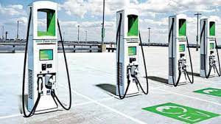
Agenda
Introduction
Objective
Literature Review
Analysis of literature review
Problem Statement
Architectural diagram
Organization Chart
Modules
Conclusion and future enhancement
References

Slide 3
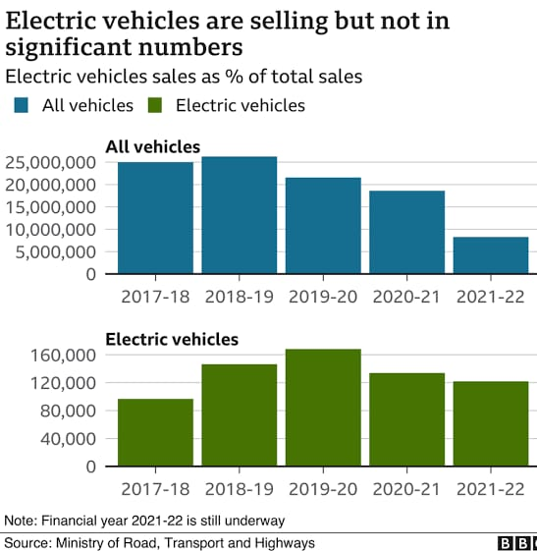
INTRODUCTION
Electric vehicle charging station(EVCS) is an equipment that connects an EV to a source of electricity to recharge the electric vehicles.
As per a recent study, electric vehicles (EVs) market is expected to be worth around at least ₹475 billion by 2025.

Slide 4
(CONT….)
As per the guidelines set by the government, it is compulsory to set an EV charging station at every 3 sq km area in cities and every 25km on highways, 100 kms on highways for heavy-duty vehicles. (TN occupies 6.4)
In order to make sure the proper location for charging stations, to avoid the placing of stations too nearer or too farer.

Slide 5
(Cont…)
As the average cost for a public EV charging station in India is Rs. 40-50 Lakhs. So, for setting up the charging station it will be more beneficial if only there is a minimal number of users of around 50.
Target for switching 100% EV’s by 2030. So the demand for EV charging stations will be increase.

Slide 6
OBJECTIVE
To develop and explore the optimal placement of charging stations in a certain environment. So here, electric vehicle charging stations in Chennai is described using Random Forest Algorithm, and this approach is used for identifying the optimum locations.

Slide 7
LITERATURE REVIEW
PAPER NAME: Efthymiou, Dimitrios, Katerina Chrysostomou, Maria Morfoulaki, and Georgia Aifantopoulou. "Electric vehicles charging infrastructure location: a genetic algorithm approach." European Transport Research Review 9, no. 2 (2017): 1-9.
PAPER DESCRIPTION :
The Electric Vehicle Charging Infrastructure Location Problem is an optimization problem that can be approached by linear programming, multi-objective optimization and genetic algorithms have been developed in R and tested in European cities.

Slide 8
LITERATURE REVIEW
PAPER NAME: Wang, Hengsong, Qi Huang, Changhua Zhang, and Aihua Xia. "A novel approach for the layout of electric vehicle charging station." In The 2010 International Conference on Apperceiving Computing and Intelligence Analysis Proceeding, pp. 64-70. IEEE, 2010.
PAPER DESCRIPTION :
This paper presents a multi-objective planning model which is comprehensive for the layout of electric vehicle charging station taking in account factors including electric vehicles sustainable development, characters of charging station, characters of charging consumers, distribution of the charging demand, the power grid and factors of municipal planning. Then a solution algorithm is designed based on demand priority and the usage of the existing gas station.

Slide 9
LITERATURE REVIEW
PAPER NAME: Hanabusa, Hisatomo, and Ryota Horiguchi. "A study of the analytical method for the location planning of charging stations for electric vehicles." In International Conference on Knowledge-Based and Intelligent Information and Engineering Systems, pp. 596-605. Springer, Berlin, Heidelberg, 2011.
PAPER DESCRIPTION :
This study describes an analytical method for the location planning of charging stations for electric vehicles (EVs). In this paper, the theoretical framework of the optimum location of charging stations is explained.

Slide 10
ANALYSIS OF LITERATURE REVIEW
LITERATURE SURVEY | IMPLEMENTED | NOT ENHANCED
LITERATURE SURVEY 1 | The Electric Vehicle Charging Infrastructure Location Problem is an optimization problem that can be approached by linear programming, multi-objective optimization and genetic algorithms have been developed in R and tested in European cities. | Optimization method is implemented for EV’s and there is no future prediction for charging stations.
LITERATURE SURVEY 2 | The layout of electric vehicle charging station taking in factors including electric vehicles sustainable development, characters of charging station, characters of charging consumers, distribution of the charging demand, the power grid and factors of municipal planning. Then a solution algorithm is designed based on demand priority and the usage of the existing gas station. | Demand priority with several similarity measuring techniques and existing station analysis on a larger dataset is only included

Slide 11
ANALYSIS OF LITERATURE REVIEW
LITERATURE SURVEY | IMPLEMENTED | NOT ENHANCED
LITERATURE SURVEY 3 | This study describes an analytical method for the location planning of charging stations for electric vehicles. In this paper, the theoretical framework of the optimum location of charging stations is explained. | Here the near by charging stations is not recommended and the distance coverage of the user is not specified.

Slide 12
PROBLEM STATEMENT
STATEMENT 1
To cover the demand of electrical charging location for the convenience of the number of electric vehicle users with the distance of EV stations.
STATEMENT 2
To build the total social cost model based on economic cost by adopted random forest algorithms to solve objective optimization problems.
STATEMENT 3
To design and develop the optimal charging location for Ev’s using Random Forest Algorithm with real-time data.

Slide 13
MODULE-1
YEAR
EXISTING EV STATION
PREDICTION
OUTPUT
INPUT
NO. OF CHARGING
STATIONS
Collecting the data sets like number of charging stations and year for calculating the electric vehicle charging stations in existing year.

Slide 14
MODULE-2
YEAR
FUTURE EV STATION
PREDICTION
OUTPUT
INPUT
NO. OF CHARGING
STATIONS
Collecting the data sets like number of charging stations and year for predicting the electric vehicle charging stations for upcoming years .

Slide 15
MODULE-3
TYPE OF VEHICLE
KILOMETERS
COVERAGE
EV STATION
RECOMMENDATION
FOR USER
OUTPUT
INPUT
DISTANCE COVERAGE
OF ELECTRIC
VEHICLE
Electric vehicle charging station recommendation based on user requirements like user’s type of electric vehicle and kilometer coverage.

Slide 16
ORGANIZATIONAL CHART
RANDOM FOREST ALGORITHM
E-VEHICLES DATASET
TRAIN ACCURACY
TEST DATA
TRAINED MODEL
DATA PREPROCESS
TEST ACCURACY
DATA HEADER
SEGMENTATION
PREDICTION
RESULT
SPLIT TEST AND
TRAIN MODULE
EV STATION
RECOMMENDATION
FOR USER
NO. OF CHARGING
STATIONS IN FUTURE
EXISTING
CHARGING STATION

Slide 17
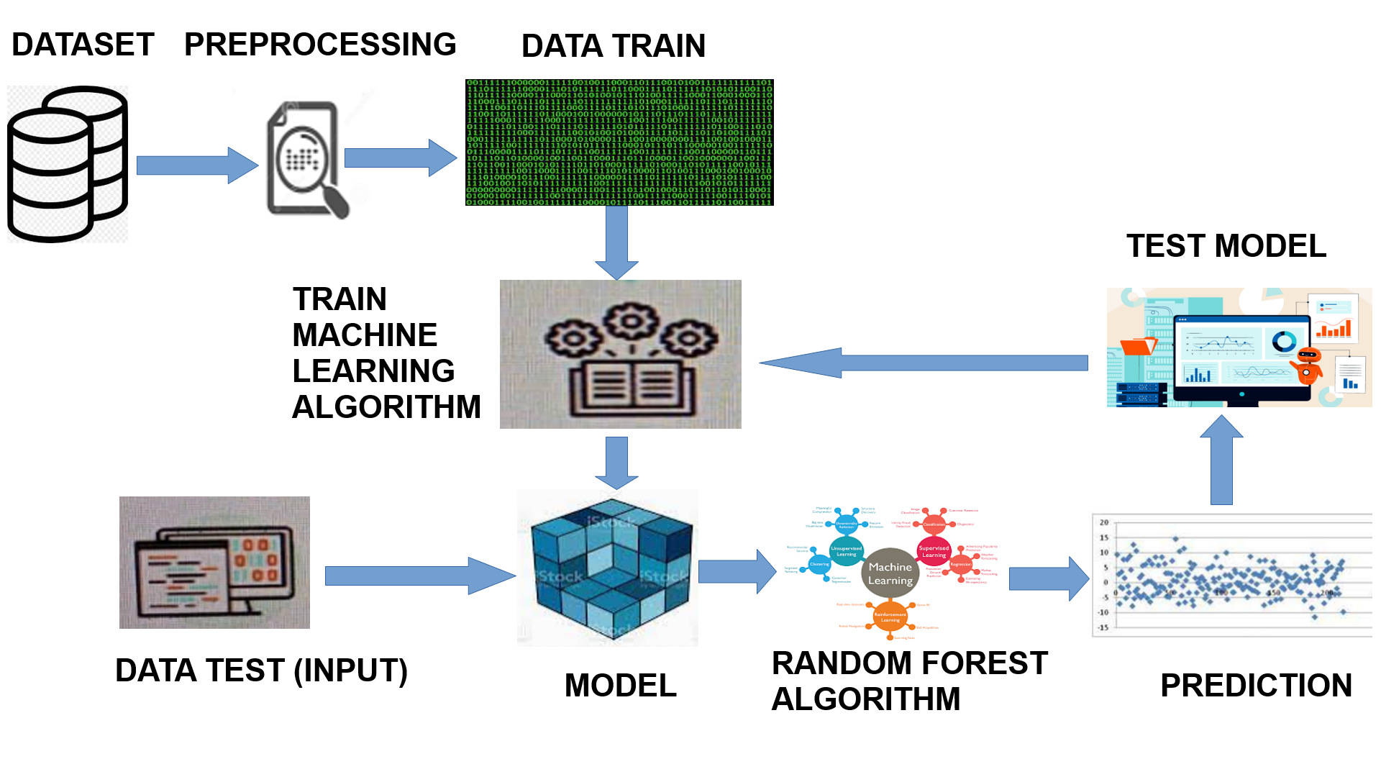
ARCHITECTURAL DIAGRAM

Slide 18
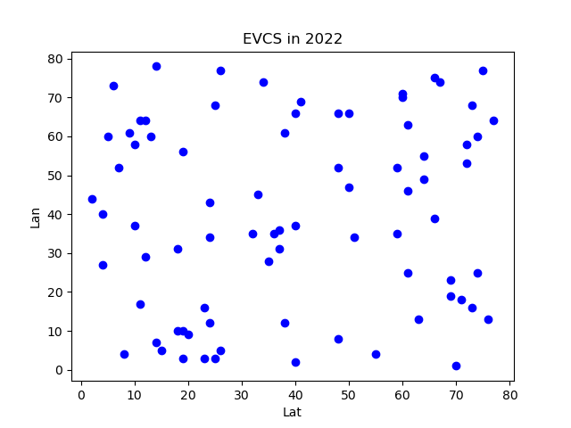
Experimental output:
Existing Charging Station
Charging Station estimation (2022): 72

Slide 19
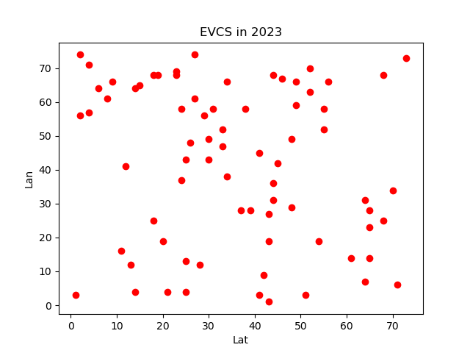
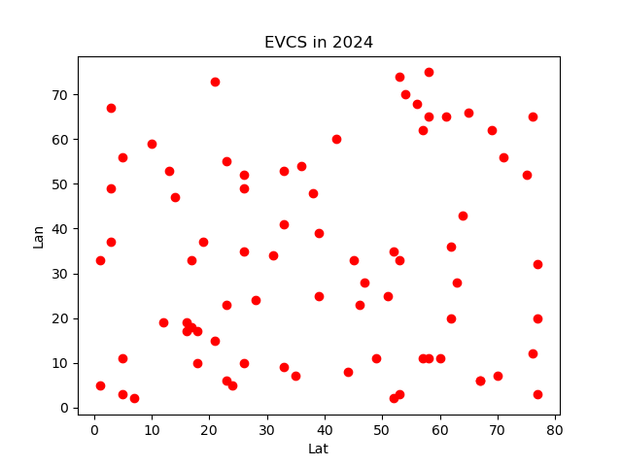
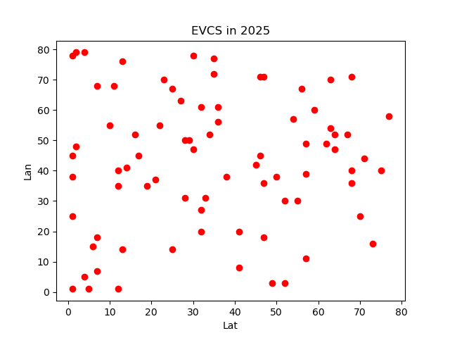
Experimental output:
Charging Station estimations
Year | Predicted no. of stations in future | Demand coverage of Electric vehicles
2022 | 72 | 88%
2023 | 74
2024 | 77
2025 | 79

Slide 20
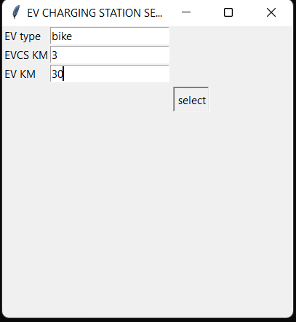
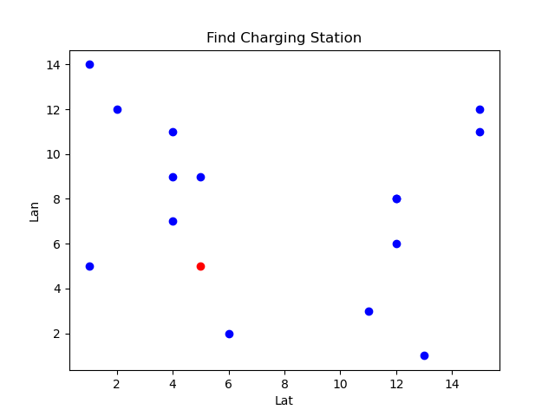
Experimental output:
Recommendation of charging stations for the user requirement

Slide 21
CONCLUSION This system fills the gap in literature by adopting reasonable location. Here it focus on demand priority, mileage, EV distribution in this study. Linear regression and classification in random forest model are developed to analyze the charging frequencies and sharing charging level for the charging stations. Through a case study of areas in Tamil Nadu, this system approach, an optimization problem is defined for addressing the location problem of EVs charging stations to improve the sharing charging level.

Slide 22
Future Enhancement
The future work is aimed to develop the Android application in an user friendly manner which will give the clear spot of the charging location of the charging stations and to accommodate with some other features like giving an alert for the user when an charging point of the electric vehicle gets low.

Slide 23
REFERENCES
Efthymiou, Dimitrios, Katerina Chrysostomou, Maria Morfoulaki, and Georgia Aifantopoulou. "Electric vehicles charging infrastructure location: a genetic algorithm approach." European Transport Research Review 9, no. 2 (2017): 1-9.
Efthymiou, Dimitrios, Constantinos Antoniou, Yannis Tyrinopoylos, and Evangelos Mitsakis. "Spatial Exploration of Effective electric vehicle infrastructure location." Procedia-Social and Behavioral Sciences 48 (2012): 765-774

Slide 24
REFERENCE (CONTI..)
Hanabusa, Hisatomo, and Ryota Horiguchi. "A study of the analytical method for the location planning of charging stations for electric vehicles." In International Conference on Knowledge-Based and Intelligent Information and Engineering Systems, pp. 596-605. Springer, Berlin, Heidelberg, 2011.
Adepetu, A., Keshav, S., and Arya, V. 2016. "An agent-based electric vehicle ecosystem model: San Francisco case study". Transport Policy 46:109-122.

Slide 25
REFERENCE (CONTI..)
Axsen, J., and Kurani, K. S. 2010. "Anticipating plug-in hybrid vehicle energy impacts in California: Constructing consumer-informed recharge profiles". Transportation Research Part D: Transport and Environment 15(4): 212-219
Sweda, Timothy, and Diego Klabjan. "An agent-based decision support system for electric vehicle charging infrastructure deployment." In 2011 IEEE Vehicle Power and Propulsion Conference, pp. 1-5. IEEE, 2011.

Slide 26
REFERENCE(CONTI...)
Worley, Owen, Diego Klabjan, and Timothy M. Sweda. "Simultaneous vehicle routing and charging station siting for commercial electric vehicles." In 2012 IEEE International Electric Vehicle Conference, pp. 1-3. IEEE, 2012.
https://evreporter.com/indias-electric-vehicle-sales-trend-january-2022
Efthymiou, Dimitrios, Constantinos Antoniou, Yannis Tyrinopoylos, and Evangelos Mitsakis. "Spatial Exploration of Effective electric vehicle infrastructure location." Procedia-Social and Behavioral Sciences 48 (2012): 765-774

